Slide 1

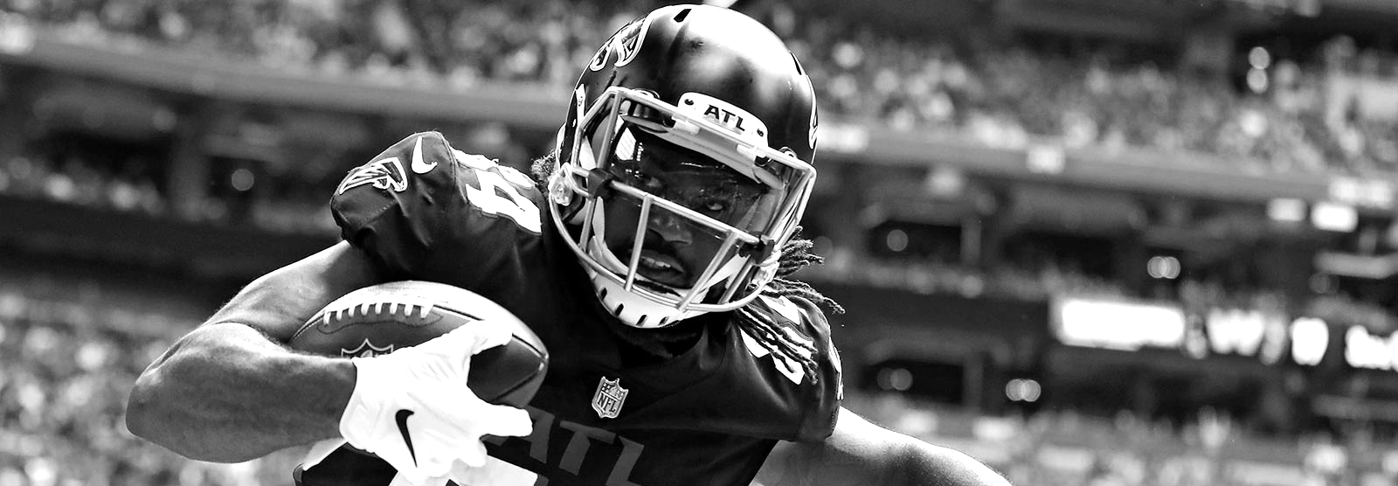
Vaughn Hajra and Quang Nguyen
FANTASY FOOTBALL BOOTSTRAPPING & SIMULATION
November 2, 2022
Stats 226

Slide 2
Overview
OVERVIEW
FANTASY FOOTBALL EXPLAINED
BOOTSTRAPPING EXAMPLES
SIMULATION EXAMPLES
APPLICATIONS AND CONCLUSIONS
01
02
03
04
Our Data
Why Fantasy Football
Basic Overview of Fantasy Scoring
Sampling and graphing for player projections.
Using Distributions to predict Wide Receiver Scoring and Stats.
Outcomes of our data
Page 2

Slide 3
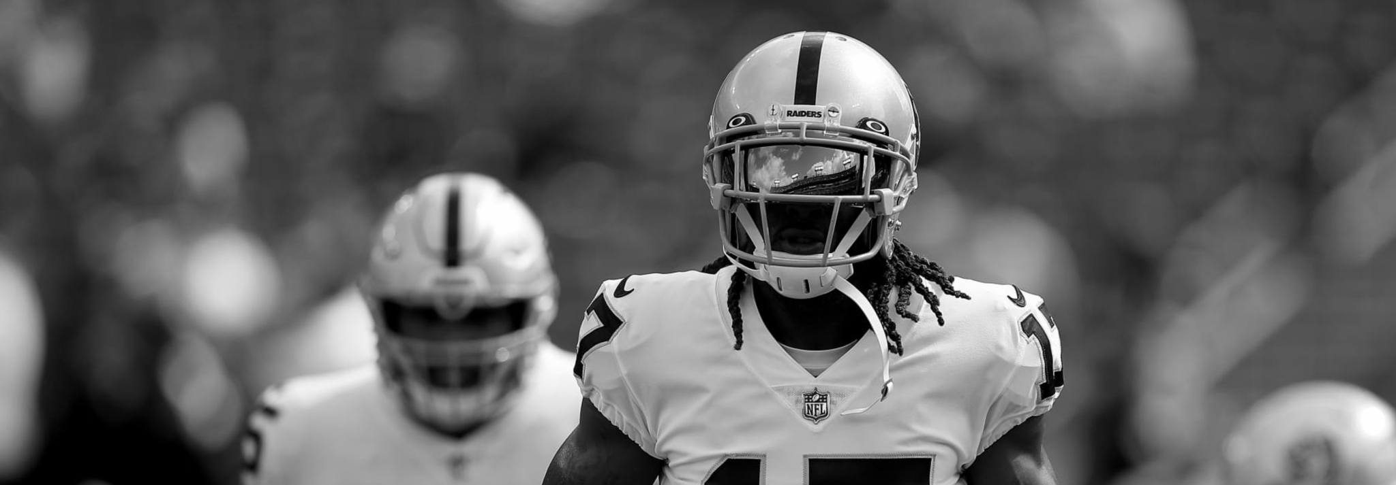
Fantasy Football,
Explained.
Fantasy Football, Explained
1. What Is Fantasy Football?
2. Fantasy Scoring, Explained
3. Our Data
Write an agenda here.
Write an agenda here.
Write an agenda here.
Page 3

Slide 4
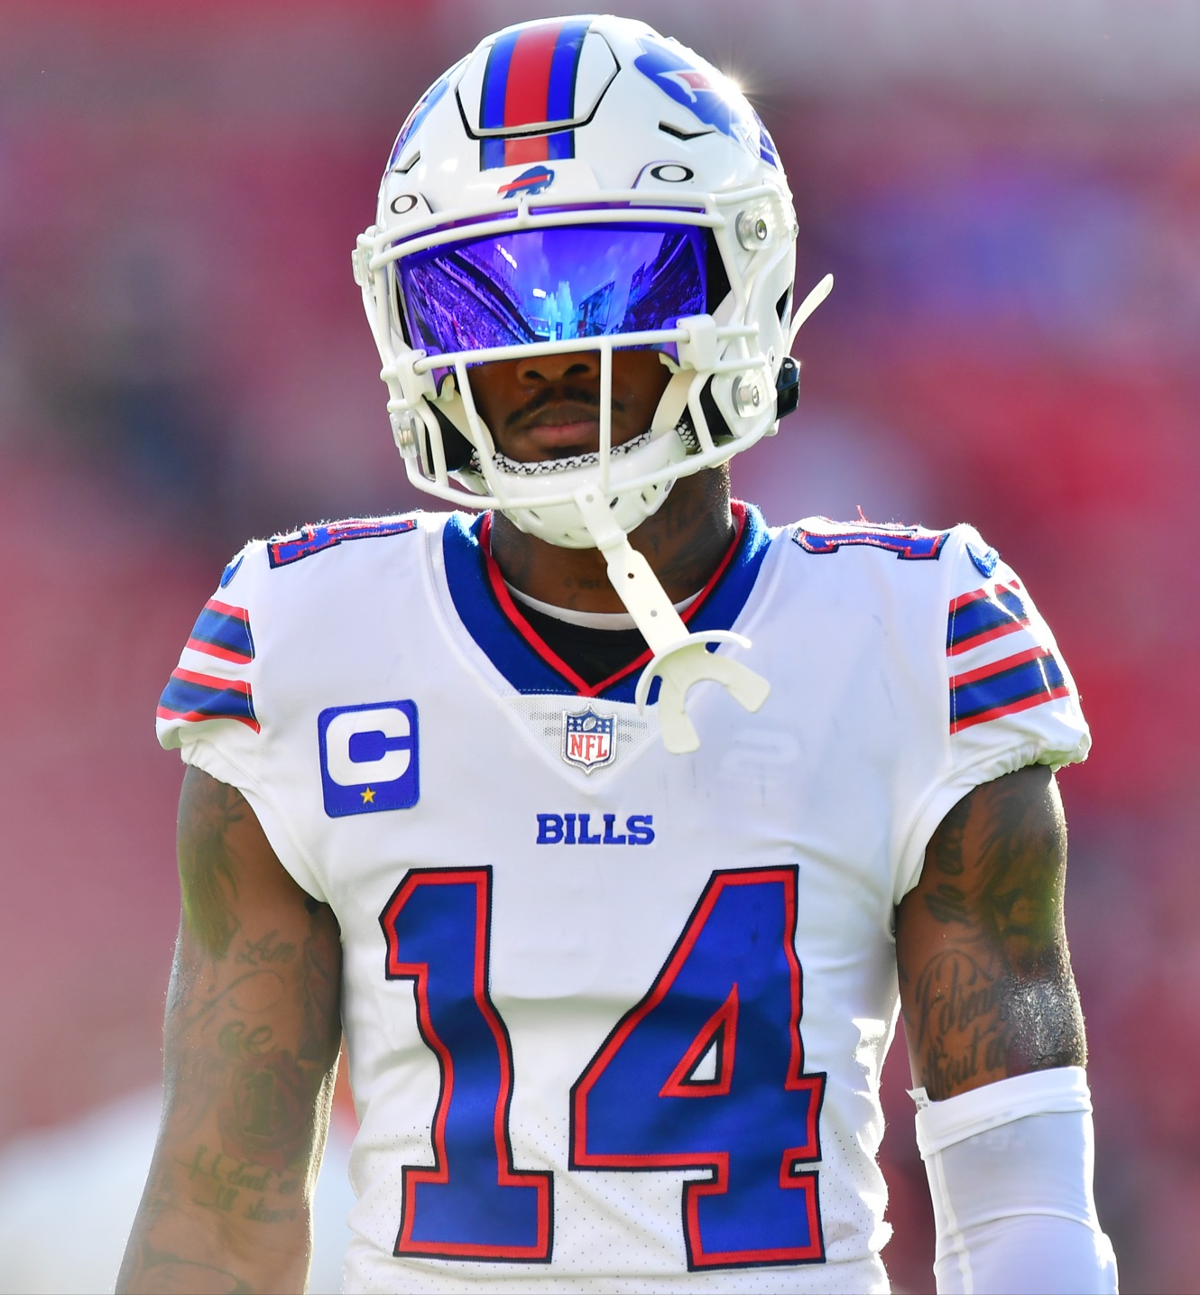
What is Fantasy Football?
What is Fantasy Football?
NFL Players earn points based on real-life stats
Fans draft players for their fantasy “team”
Goal: score more than your opponent’s team each week
Page 4

Slide 5
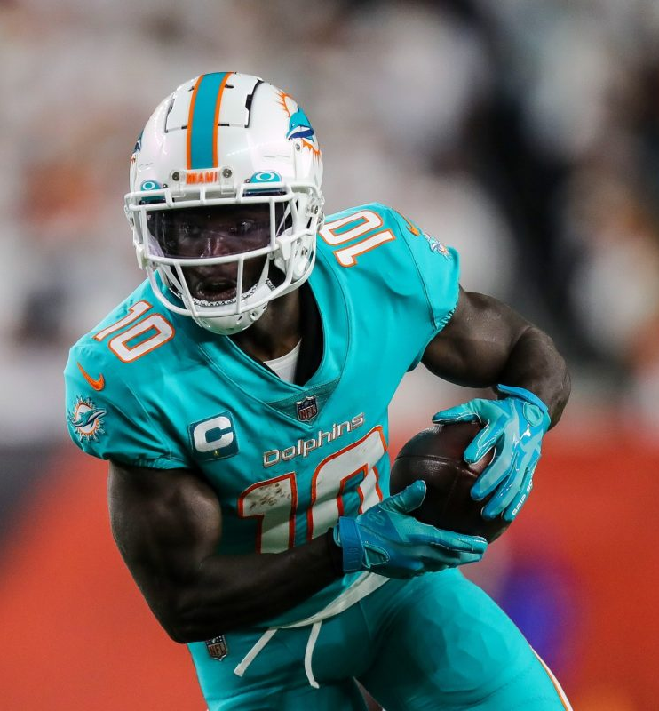
Out Data
Our Data:
2 Datasets of Interest
PPR Week 8 Projections from 6 different sources
Weekly Fantasy Data from top 50 Wide Receivers
LOTS of data wrangling to combine into datasets
Page 5

Slide 6
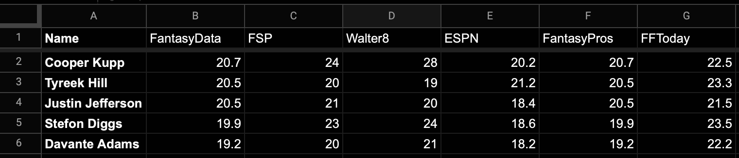
Dataset 1: Week 8 WR Fantasy Projections
DATASET 1
Data Taken from 6 different Websites
Why these players?
Benefit of Many Sources
PAGE 6

Slide 7
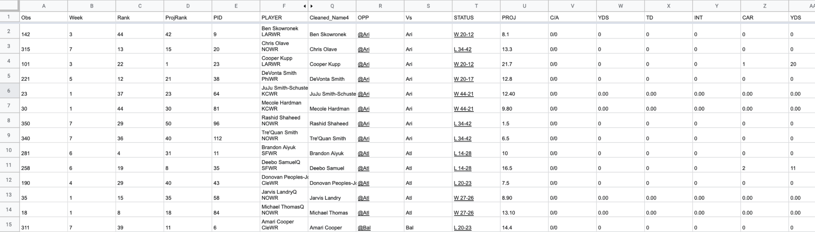
Dataset 2: ESPN PPR Weekly Wide Receiver Data
DATASET 2
Data from Weeks 1-7
Includes stats and fantasy points
Benefit: Large dataset with 350 observations
PAGE 7

Slide 8
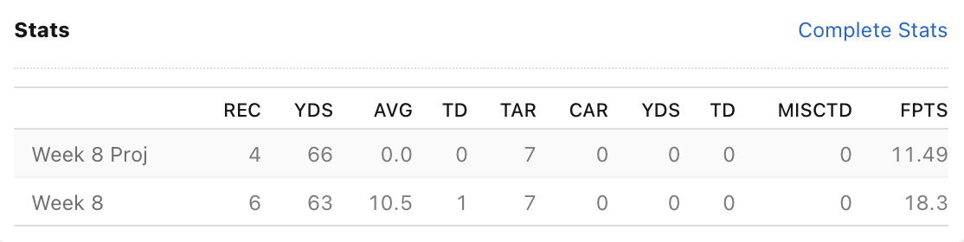
WIDE RECEIVER FANTASY FOOTBALL SCORING
WIDE RECEIVER SCORING
Example - Jerry Jeudy
RECEPTION (CATCH) | RECEIVING YARDS | TOUCHDOWN RECEPTION | RUSHING YARDS | OTHER SCORING
1.0 POINT PER RECEPTION | 0.1 POINTS PER YARD | 6 POINTS PER TOUCHDOWN | 0.1 POINTS PER YARD | FUMBLES LOST, 2PT CONVERSION
PAGE 8
Points Per Reception (PPR) Scoring

Slide 9
Bootstrapping
PART I: BOOTSTRAPPING
1. Goals and Inspiration of Bootstrapping
2. Player Selection & Data Wrangling
3. Random Sampling for Each Player
4. Player Comparisons
5. Projections & Recommendations
6. Week 8 Outcomes
BOOTSTRAPPING

Slide 10
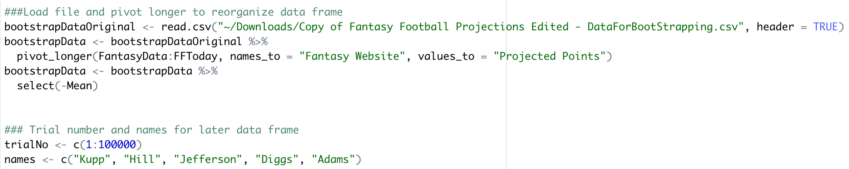
01
Preparing Data for Bootstrapping
1.1 :Preparing Bootstrap
Adding Dataset to R
pivot_longer()
trialNo and names for future compiled data frame
BOOTSTRAPPING

Slide 11
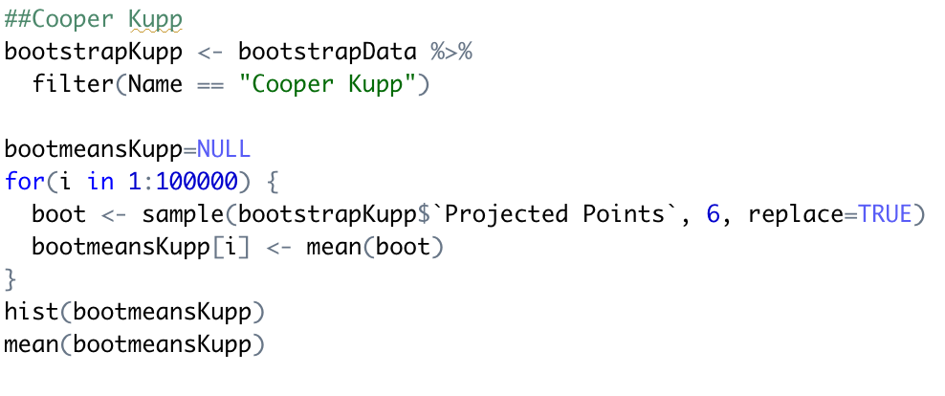
02
Bootstrapping Projections by Sampling
1.2: Sampling Projections
Example: Cooper Kupp
Dataset 1
One player at a time
6 for projected values from sources
BOOTSTRAPPING

Slide 12
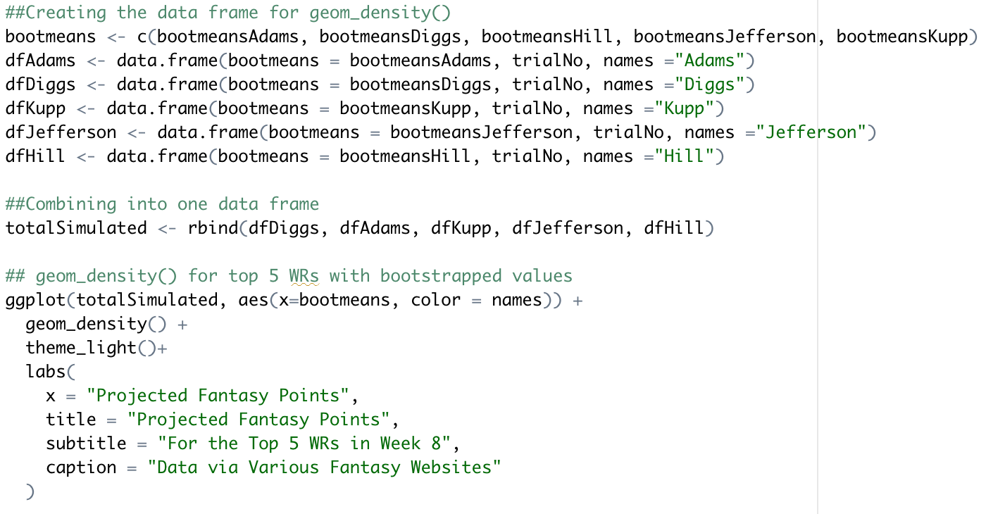
03
Creating Dataframe for Graphs
1.3 Data Frame for Graphing
BOOTSTRAPPING

Slide 13
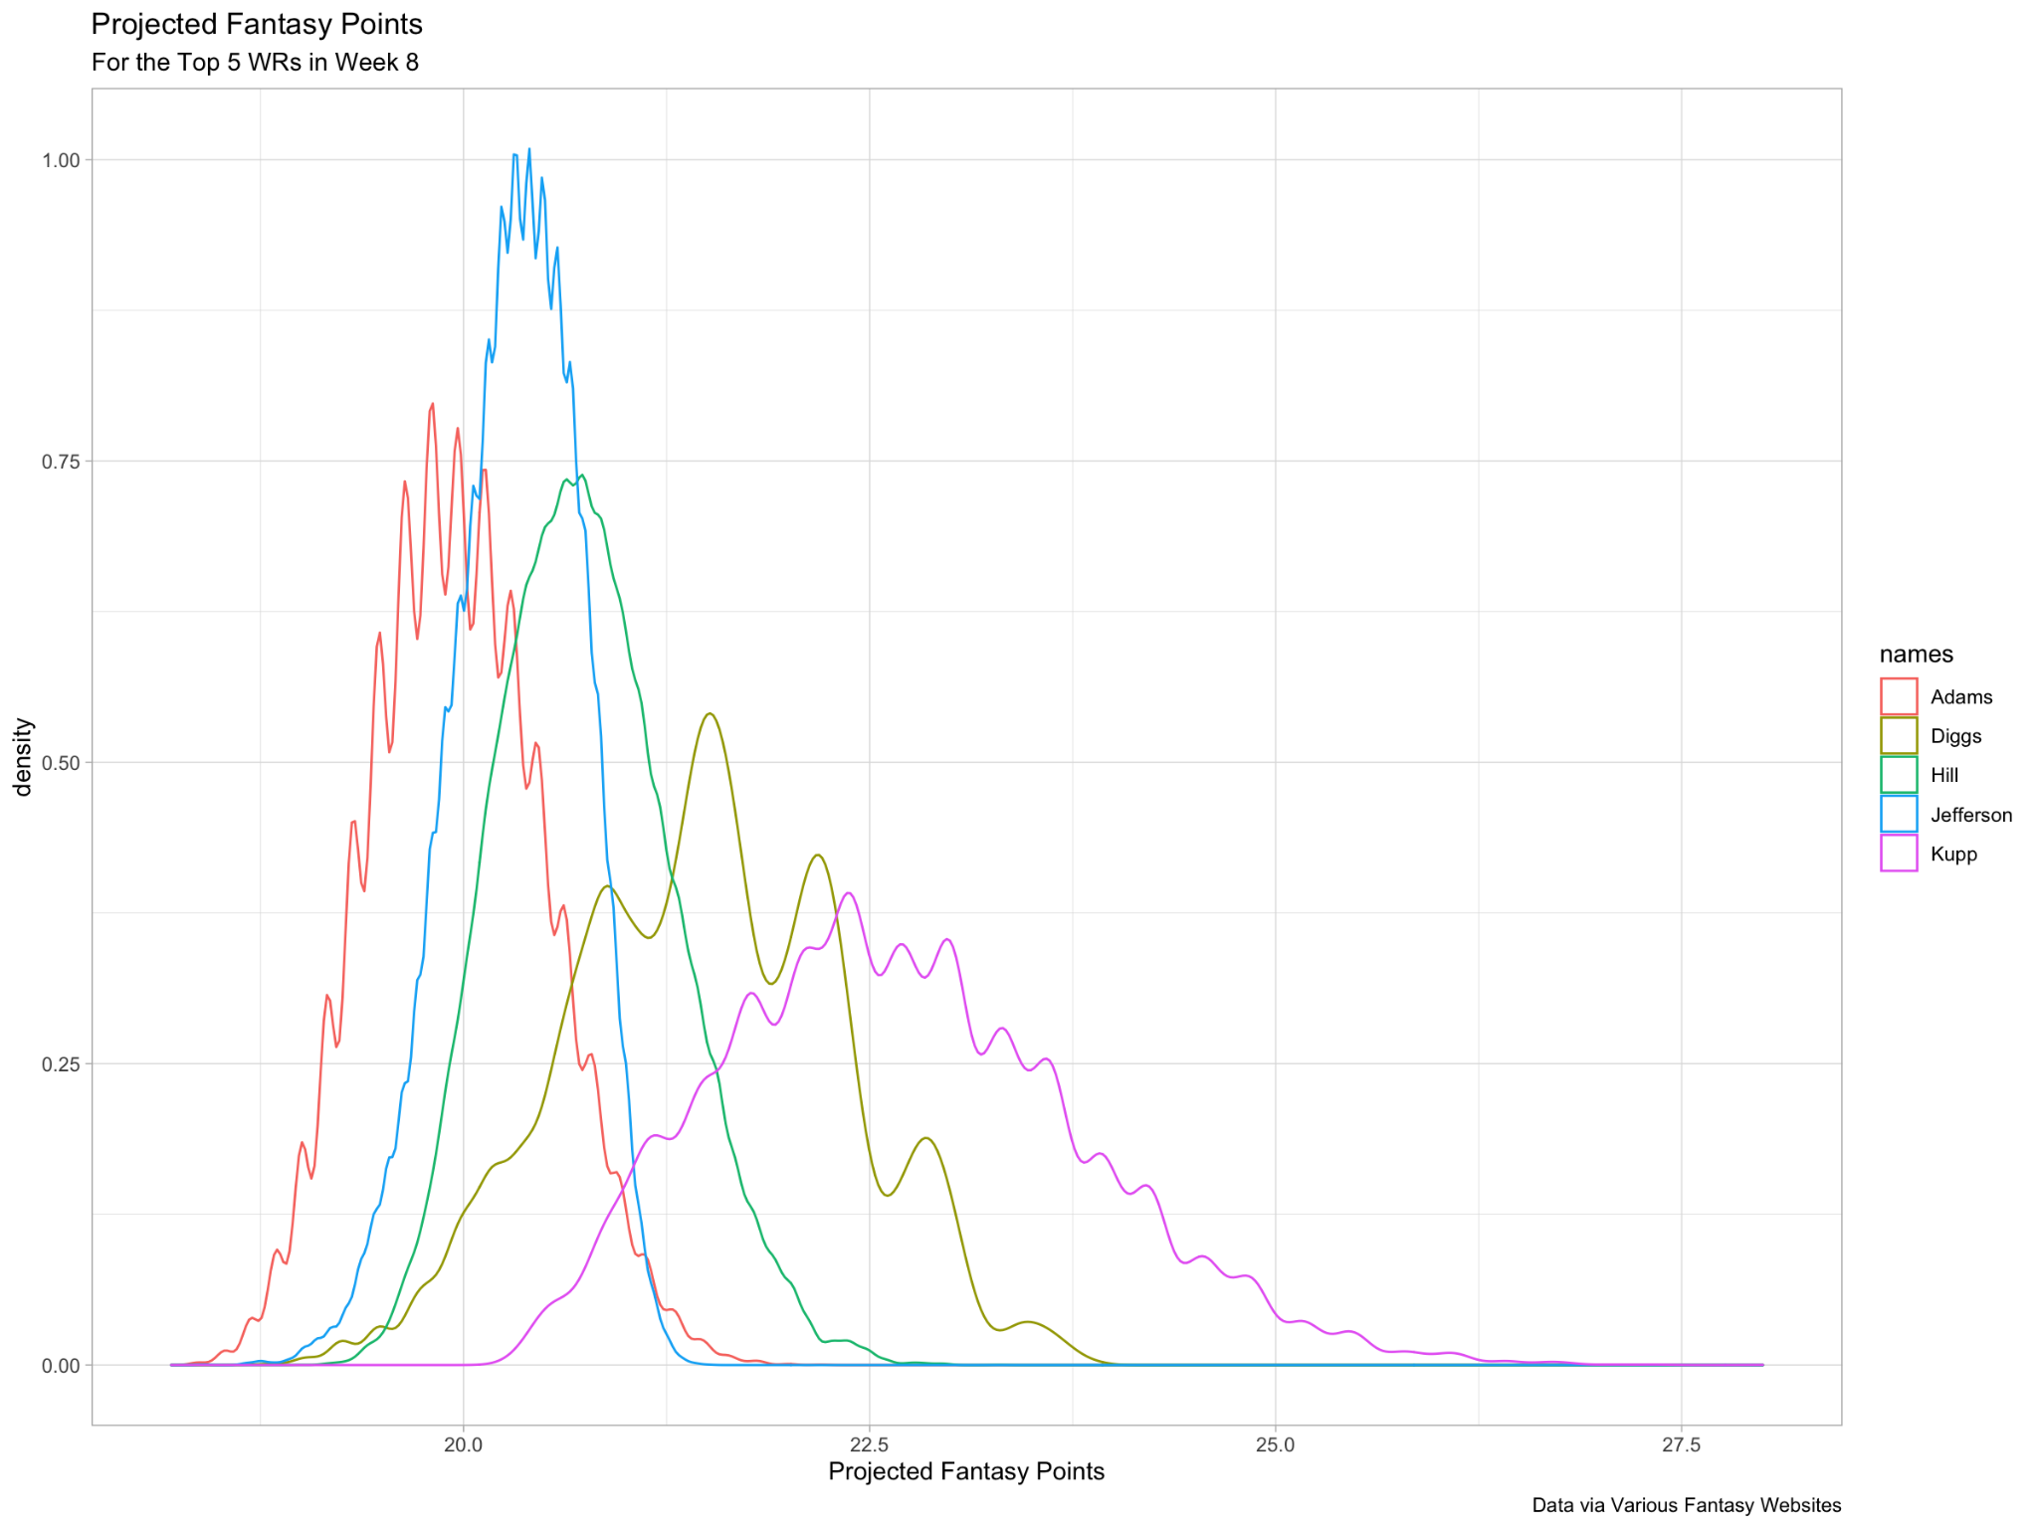
04
1.4 DENSITY PLOT
BOOTSTRAPPING
Notes:
peak vs mean talk about it

Slide 14
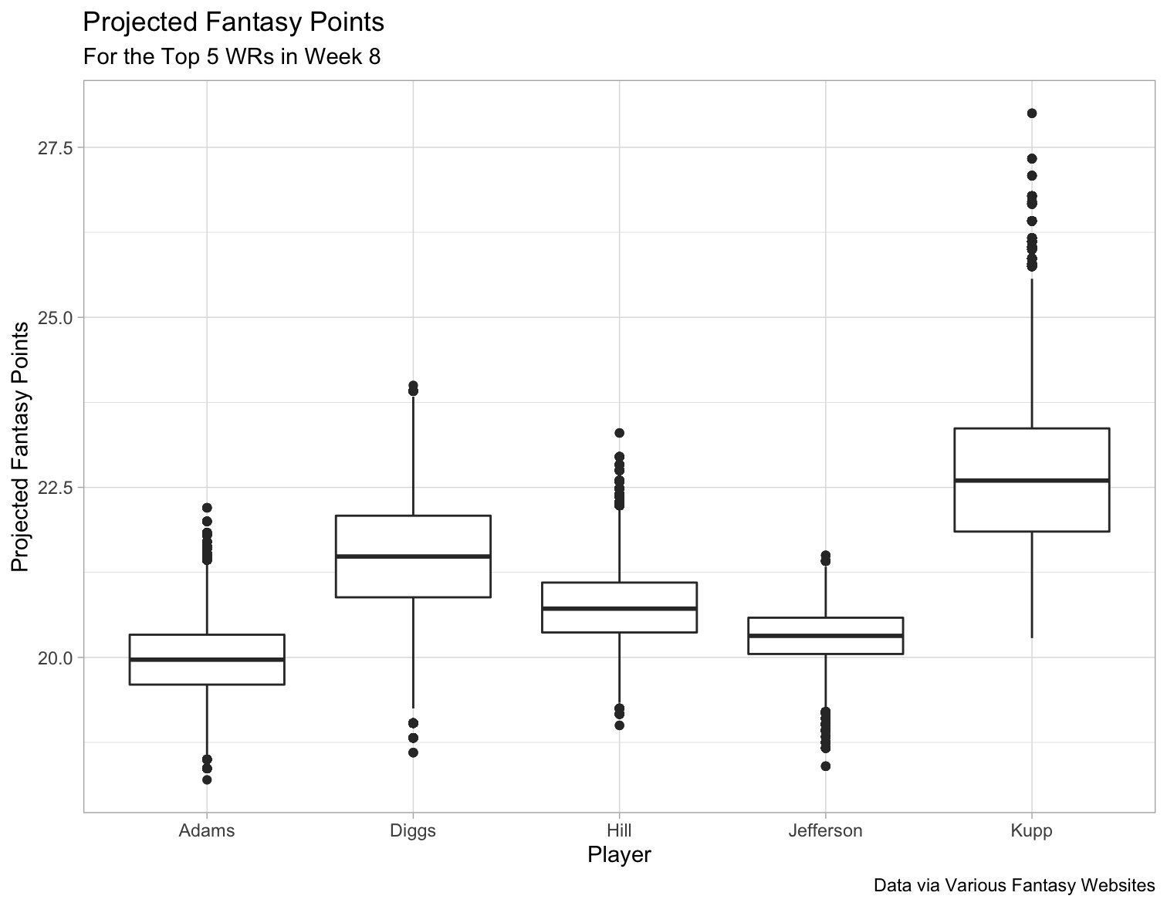
1.5 BOX PLOT
BOOTSTRAPPING

Slide 15
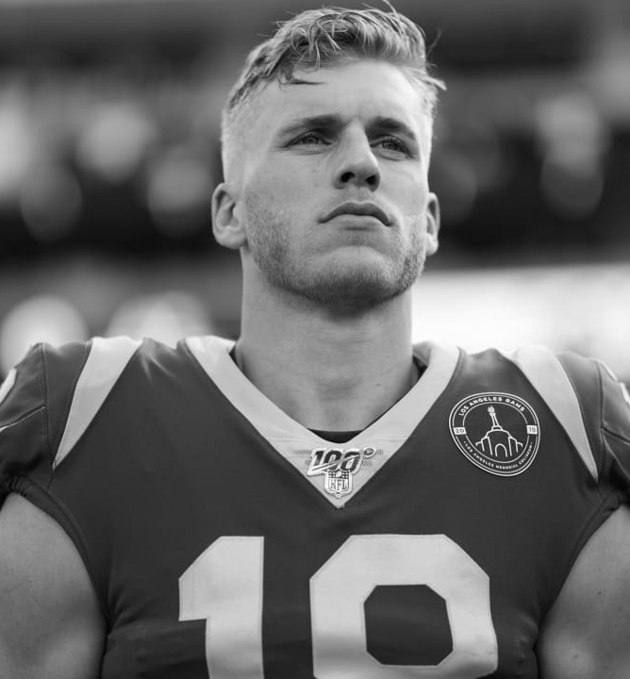
Our Suggestion:
Start Kupp and Diggs
1.,6 START THESE PLAYERS!
Both have highest means from bootstrap
Broad distribution = higher upside
Maybe due to projected touchdowns?
BOOTSTRAPPING

Slide 16
OUTCOMES AND TAKEAWAYS
CONCLUSION
PLAYER | MEAN PROJ. POINTS | ACTUAL POINTS | DIFFERENCE
COOPER KUPP | 22.681 | 22.9 | +0.219
STEFON DIGGS | 21.485 | 22.8 | +1.315
TYREEK HILL | 20.752 | 31.5 | +10.748
JUSTIN JEFFERSON | 20.319 | 15.8 | -4.519
DAVANTE ADAMS | 19.967 | 1.2 | -18.767
Kupp and Diggs performed very similarly to projected!!
Hill’s Big Day (Dolphins Scored 49 Points)
Justin Jefferson: Close but no touchdown
Davante Adams: BIG disappointment!!
BOOTSTRAPPING

Slide 17
Simulation
INTRODUCING SIMULATIONS
1. Points and the Chi Squared Distribution
2. Receiving Yards and the Gamma Distribution
3. Receptions/Targets and the Negative Binomial Distribution
SIMULATION

Slide 18
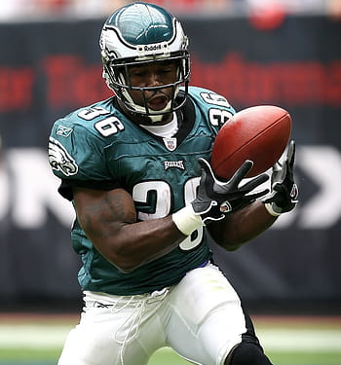
Predicting Fantasy Points:
Probability of scoring at least 10 fantasy points
PREDICTING POINTS
SIMULATION

Slide 19
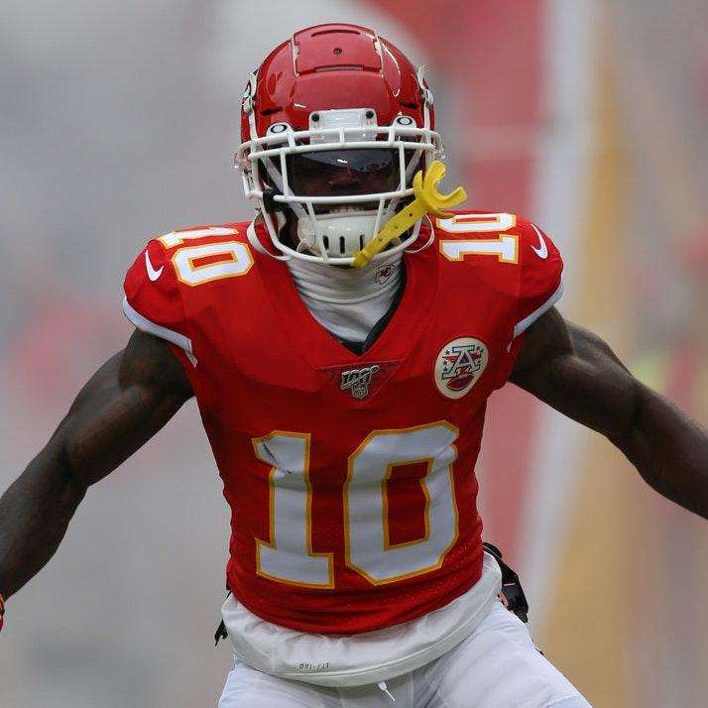
Why the Chi Squared Distribution?
WHY CHI SQUARED?
First tried Gamma distribution, ran into over-fitting issues
Trying Gamma distribution again and realized “rate” was similar to Chi Squared’s 0.5
Decision reasoning: right skewed distribution with a continuous scale that’s greater than zero.
SIMULATION

Slide 20
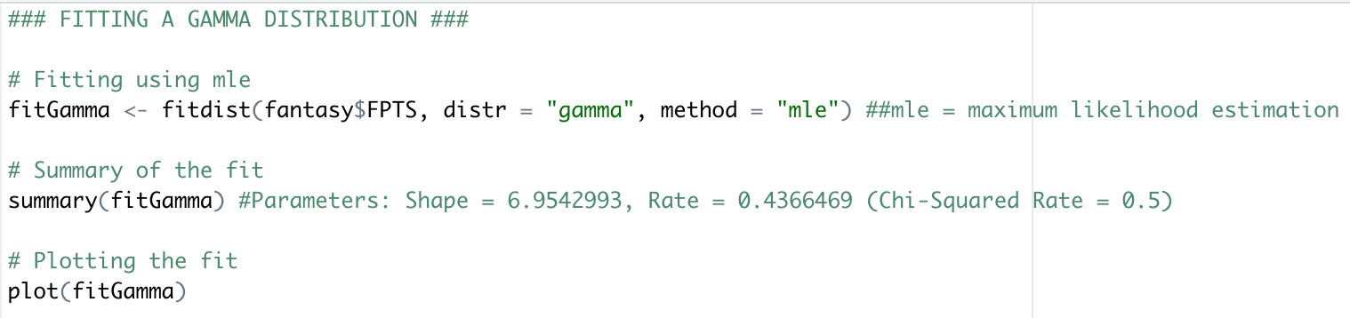
https://www.statology.org/fit-gamma-distribution-to-dataset-in-r/
FITTING THE DATA - FITDISTRPLUS PACKAGE
FITTING DATA
1. Straight-Forward Package to fit data
2. Can use for any distribution (we used Gamma and Chi-Squared)
3. Many methods of fitting (we focused on maximum likelihood estimation)
CHI SQUARED DIST.

Slide 21
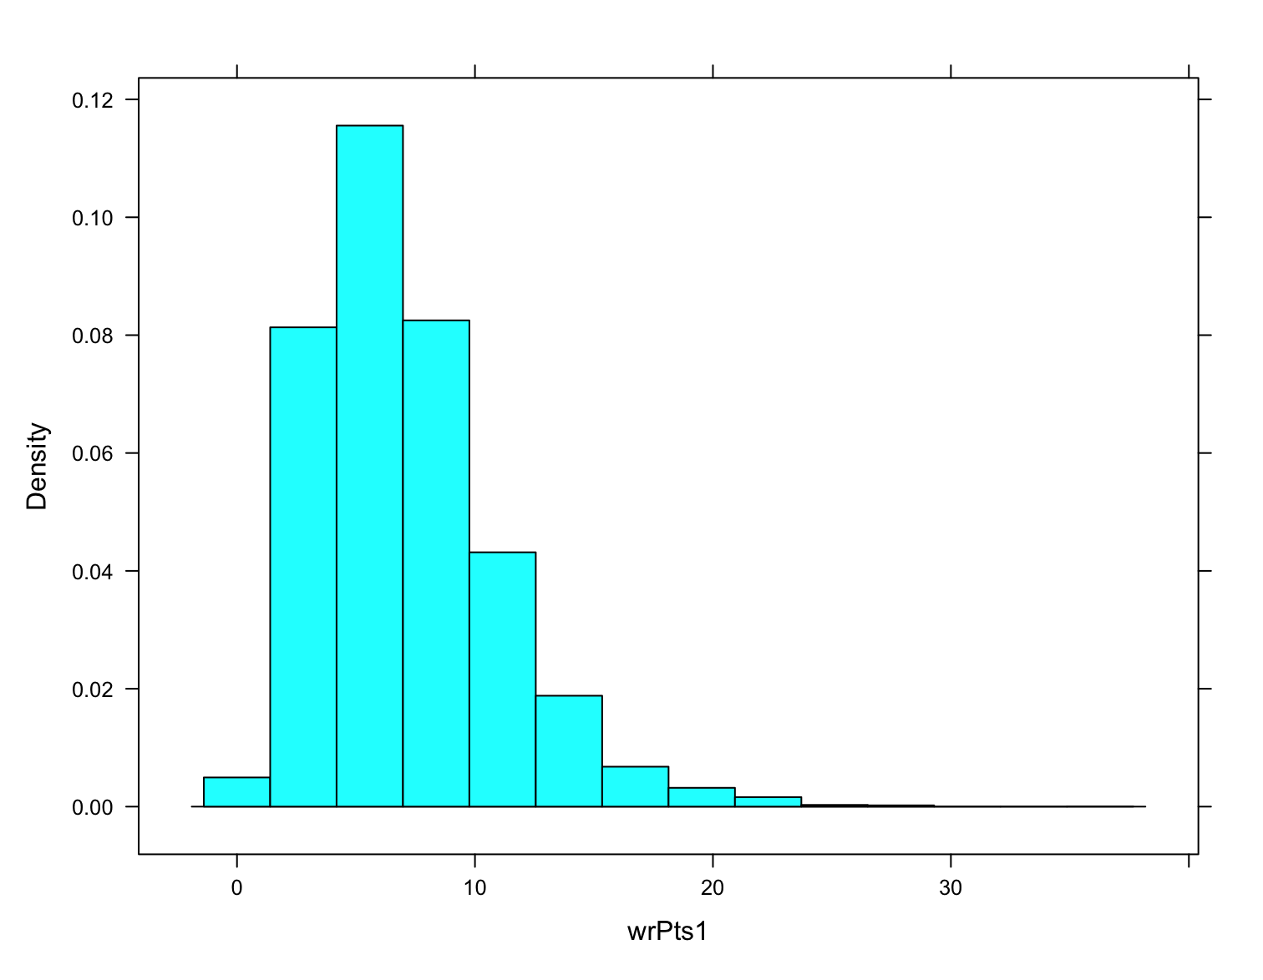
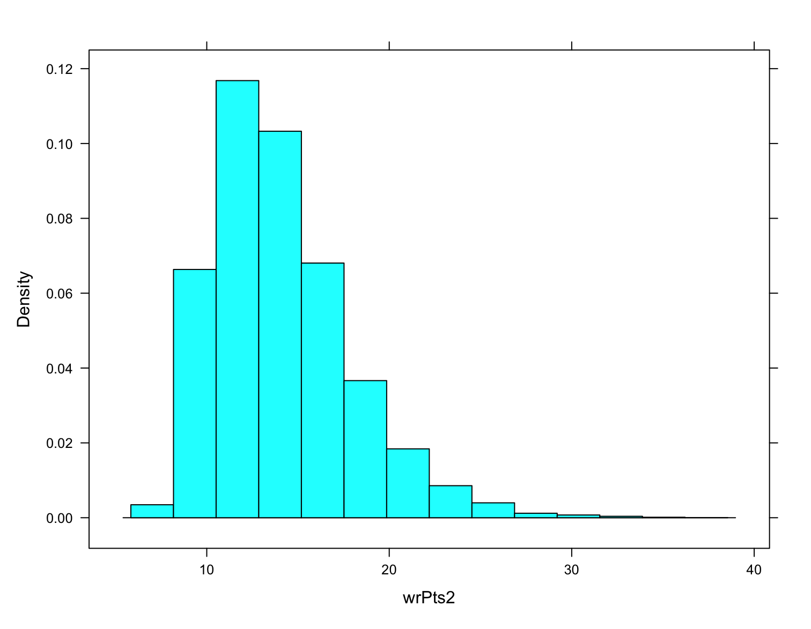
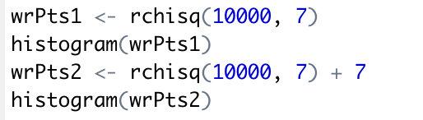
FITTING THE DATA - ADJUSTING AWAY FROM ZERO MIN
HISTOGRAM
CHI-SQUARED DIST.

Slide 22
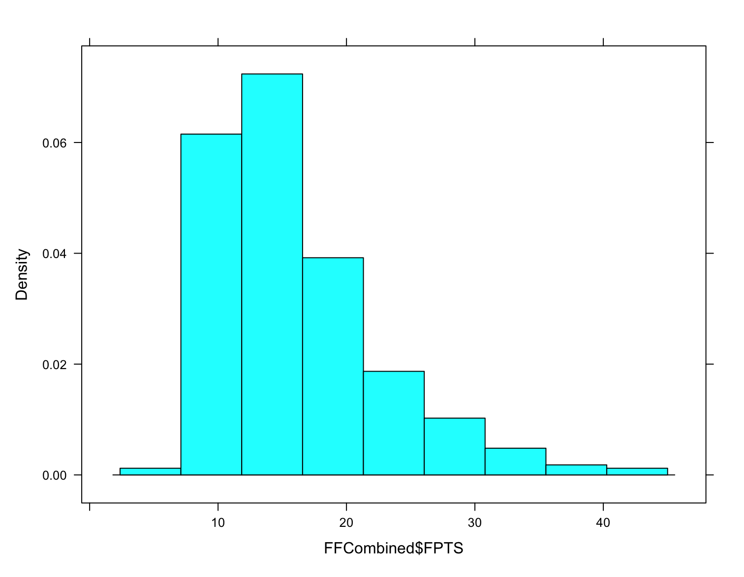
FITTING THE DATA - ACTUAL HISTOGRAM VS FITTED
HISTOGRAM: ACTUAL VS FITTED
CHI-SQUARED DIST.
1. Difference in tails
2. Why 7?

Slide 23
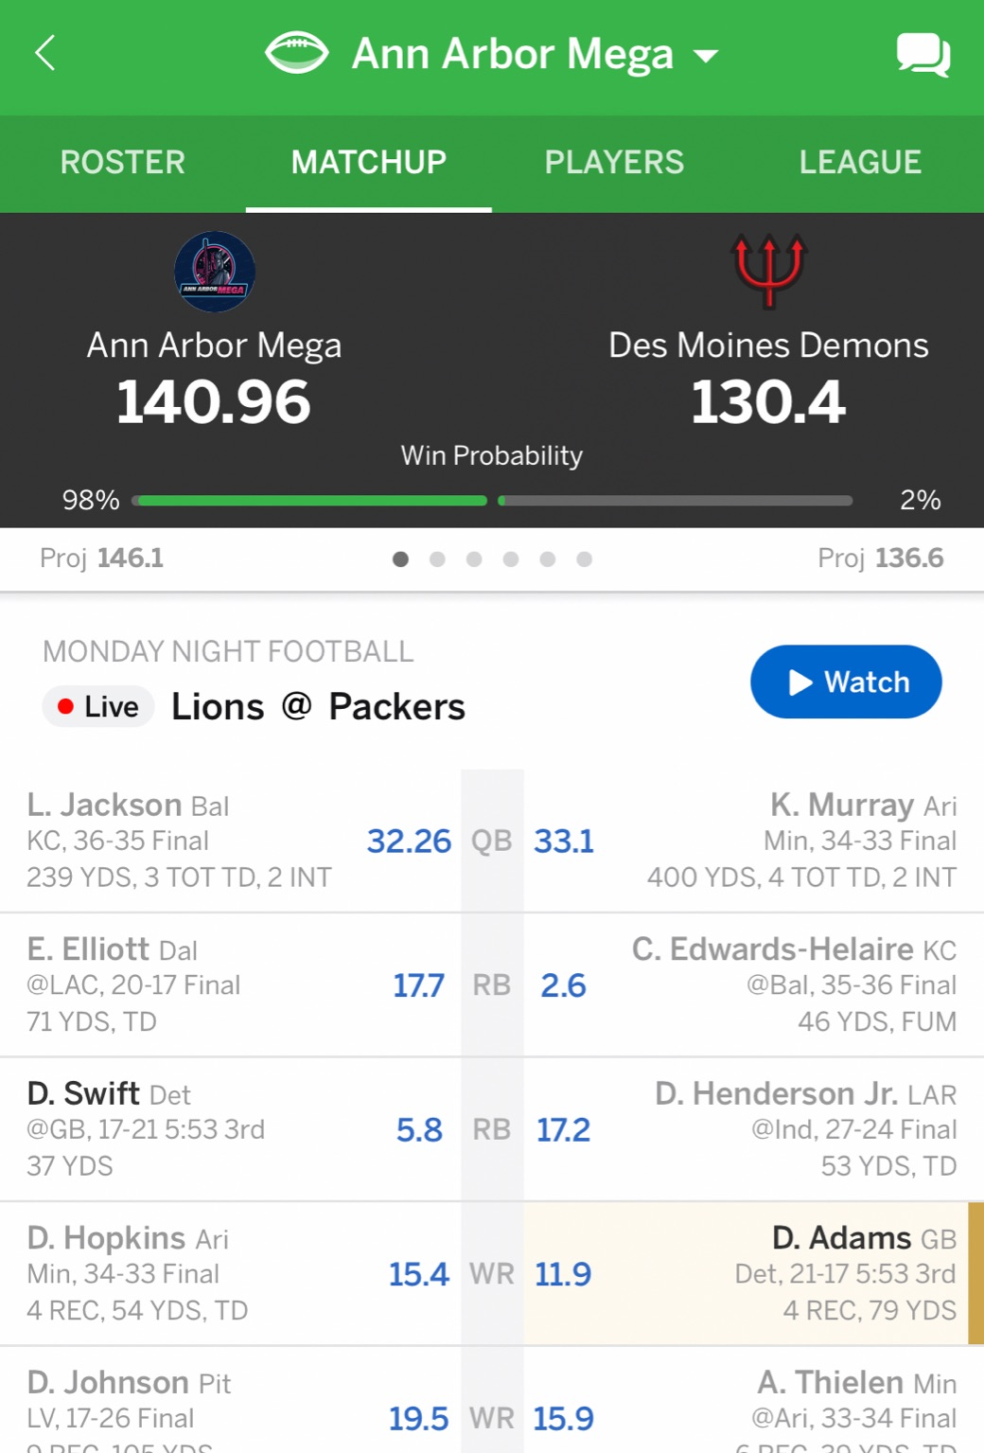
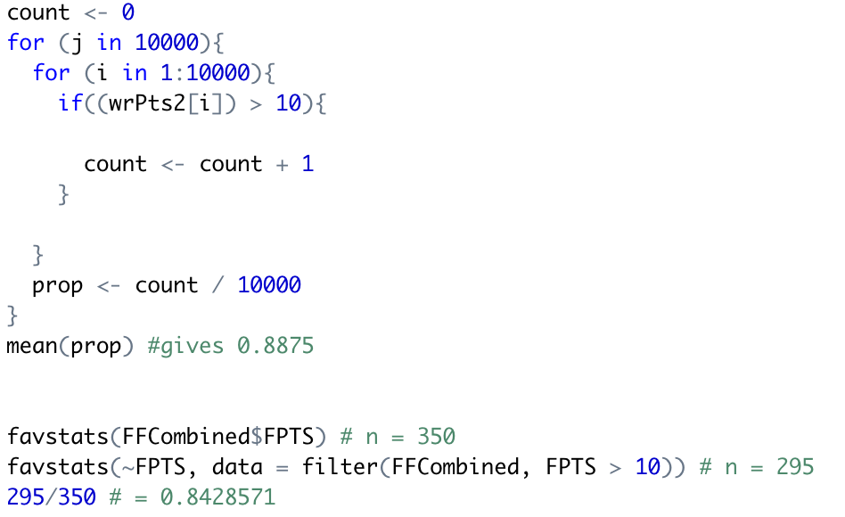
SIMULATION SCENARIO - LIKELIHOOD OF SCORING AT LEAST 10 POINTS
CONCLUSION
1. From Chi-Squared distribution: 88.75% of a random top 50 Fantasy WR ≥ 10 PPR Points
2. Simulation gives 84.29% of the top 50 players ≥ 10 PPR Points
3. Why we are satisfied with the model, and how this could be used
CHI SQUARED DIST.

Slide 24
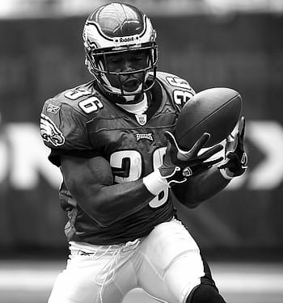
Predicting Receiving Yards:
Probability of a top 50 WR Gaining at least 75 Yards
PROJECT TIMELINE
PAGE NUMBER

Slide 25
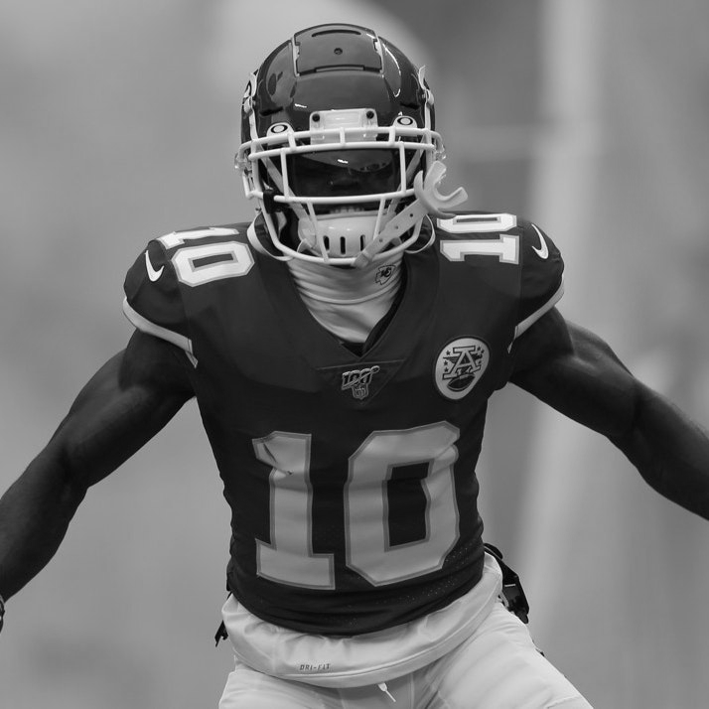
Why the Gamma Distribution
WHY GAMMA?
Positive values ranging from 0 to 250
Data was likely right-skewed
Chi-Squared didn’t match dataset regardless of degrees of freedom
GAMMA DIST.

Slide 26
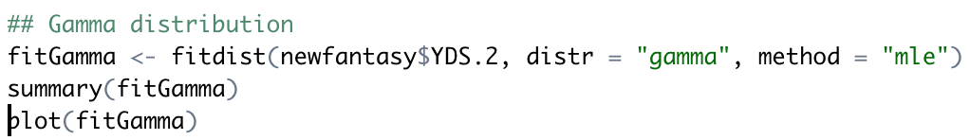
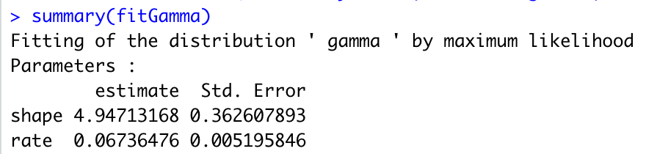
https://www.statology.org/fit-gamma-distribution-to-dataset-in-r/
FITTING THE DATA - FITDISTRPLUS PACKAGE
FITTING PARAMETERS
1. Slope of SLOPE and rate of RATE by using FitDistrPlus Package
2. Method: maximum likelihood estimation (again)
GAMMA DIST.

Slide 27
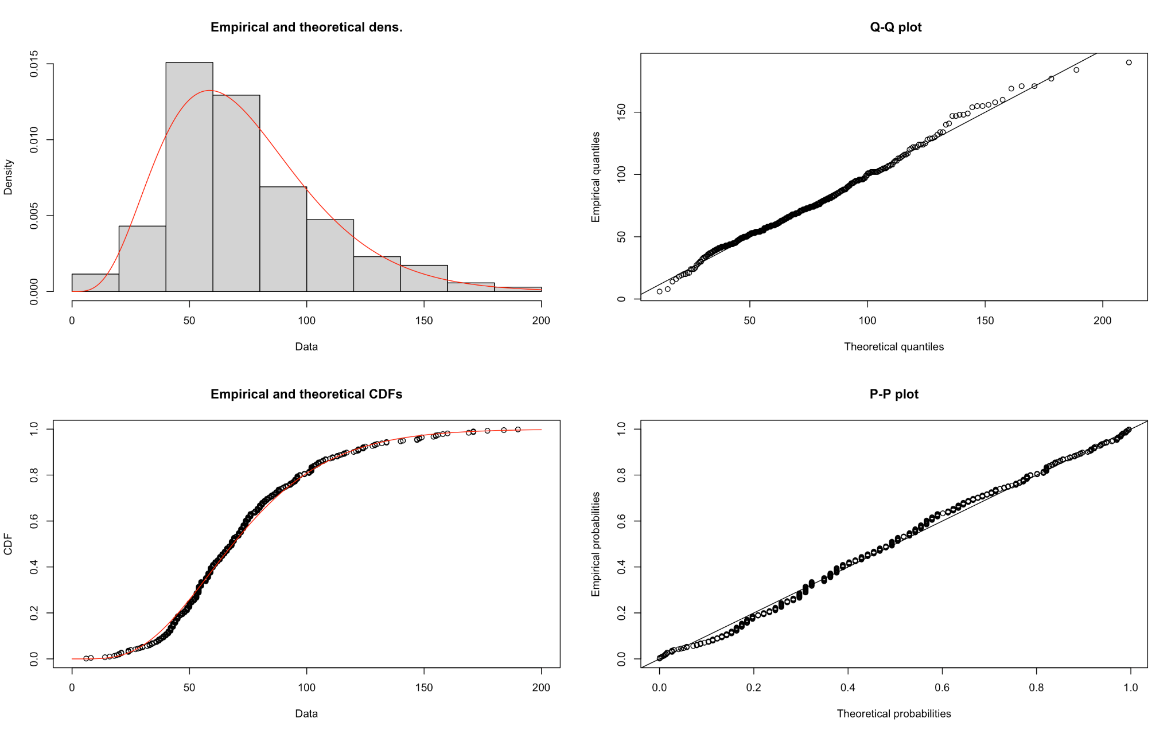
FITTING GAMMA CURVE AND OTHER PLOTS
CURVE AND CORRELATION PLOTS
GAMMA DIST.

Slide 28
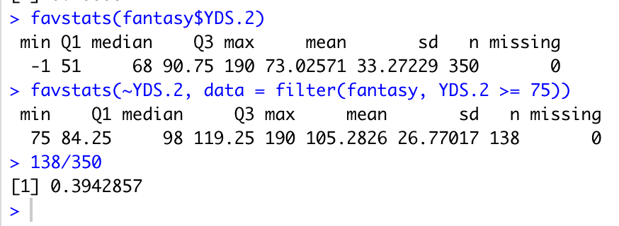
GETTING REAL RECEIVING YARDS ≥ 75 PROBABILITY
GETTING REAL PROBABILITY
GAMMA DIST.

Slide 29
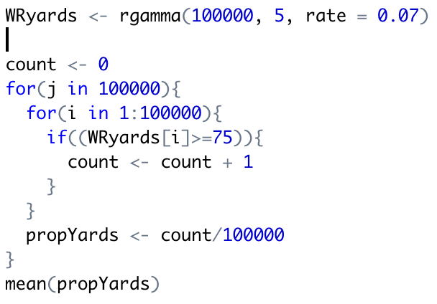
SIMULATING FOR RECEIVING YARDS EQUAL/ABOVE 75
SIMULATION
1. Using rounded parameters from summary(fitGamma)
2. Getting the mean of 100,000 proportions
3. Our result: 0.3991 or 39.91%
GAMMA DIST.

Slide 30
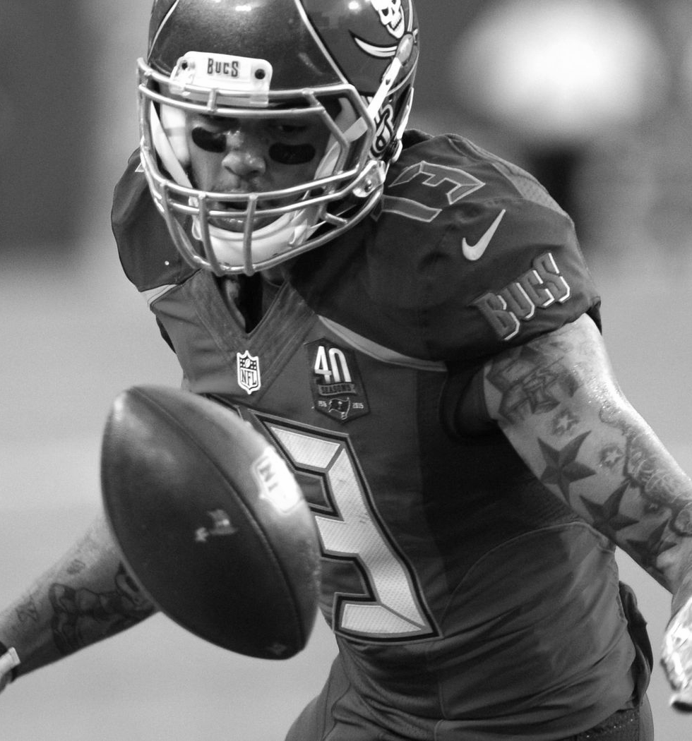
Predicting Probabilities of Making Catches:
How many targets for 6 receptions?
PROJECT TIMELINE
PAGE NUMBER

Slide 31
Why the Negative Binomial Distribution
Fantasy Football, Explained
Helps find the probability of getting at least X receptions
Had data on targets (trials) and receptions (successes)
Discrete variable that ranges greater than one
Page 4

Slide 32
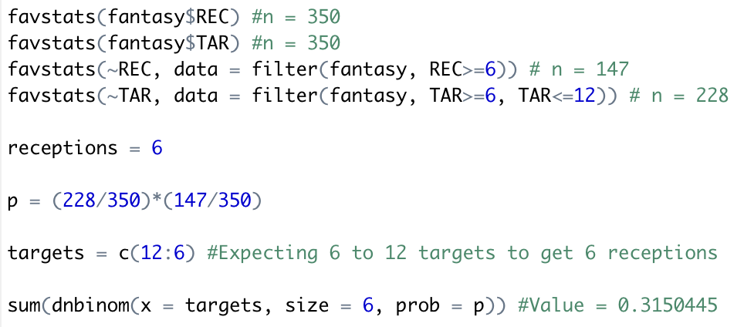
https://rpubs.com/mpfoley73/458738
ASSUMING VALUES FOR SIMULATION
WHAT VALUES TO CHOOSE?
Why receptions = 6?
Why targets are from 6 to 12?
How to calculate p from favstats data
NEGATIVE BINOMIAL DIST.

Slide 33
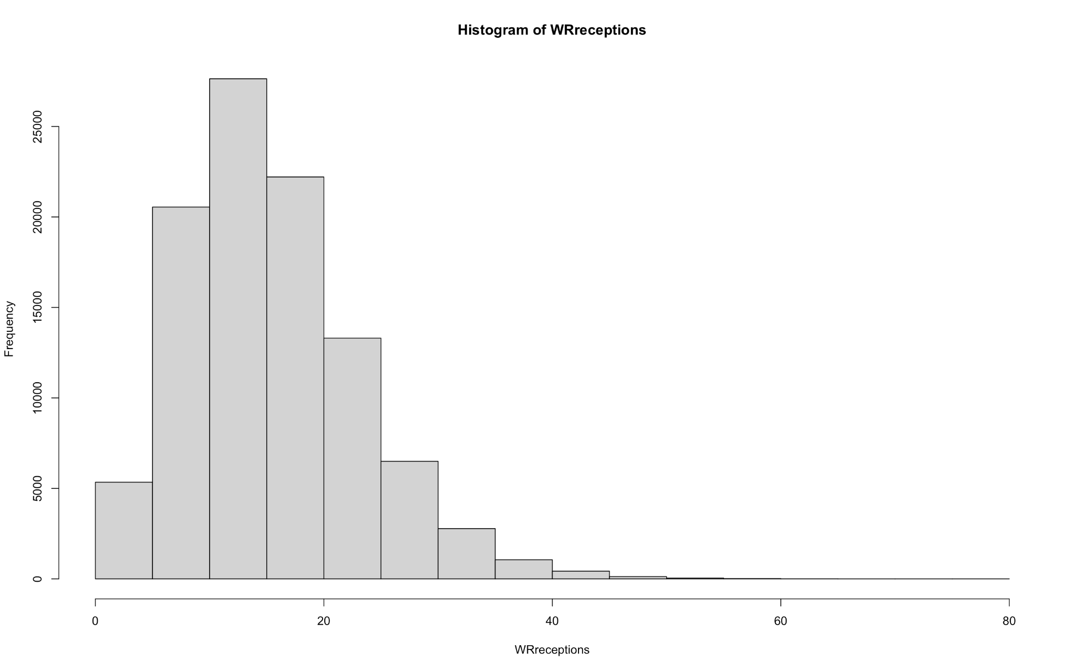
HISTOGRAM OF THE NEGATIVE BINOMIAL DISTRIBUTION
HISTOGRAM OF DISTRIBUTION
NEGATIVE BINOMIAL DIST.

Slide 34
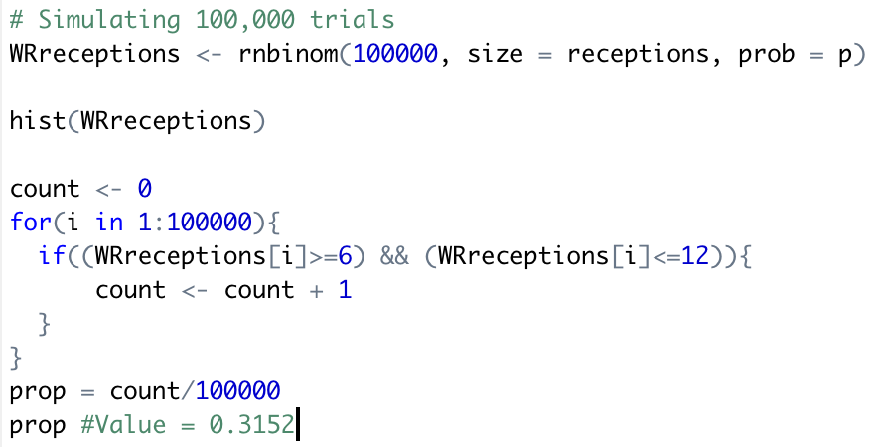
SETTING UP THE SIMULATION
SIMULATION WITH RNBINOM()
Close compared to 0.3150445 from the previous slide
Why 100,000 trials?
&& conditional argument
NEGATIVE BINOMIAL DIST.

Slide 35
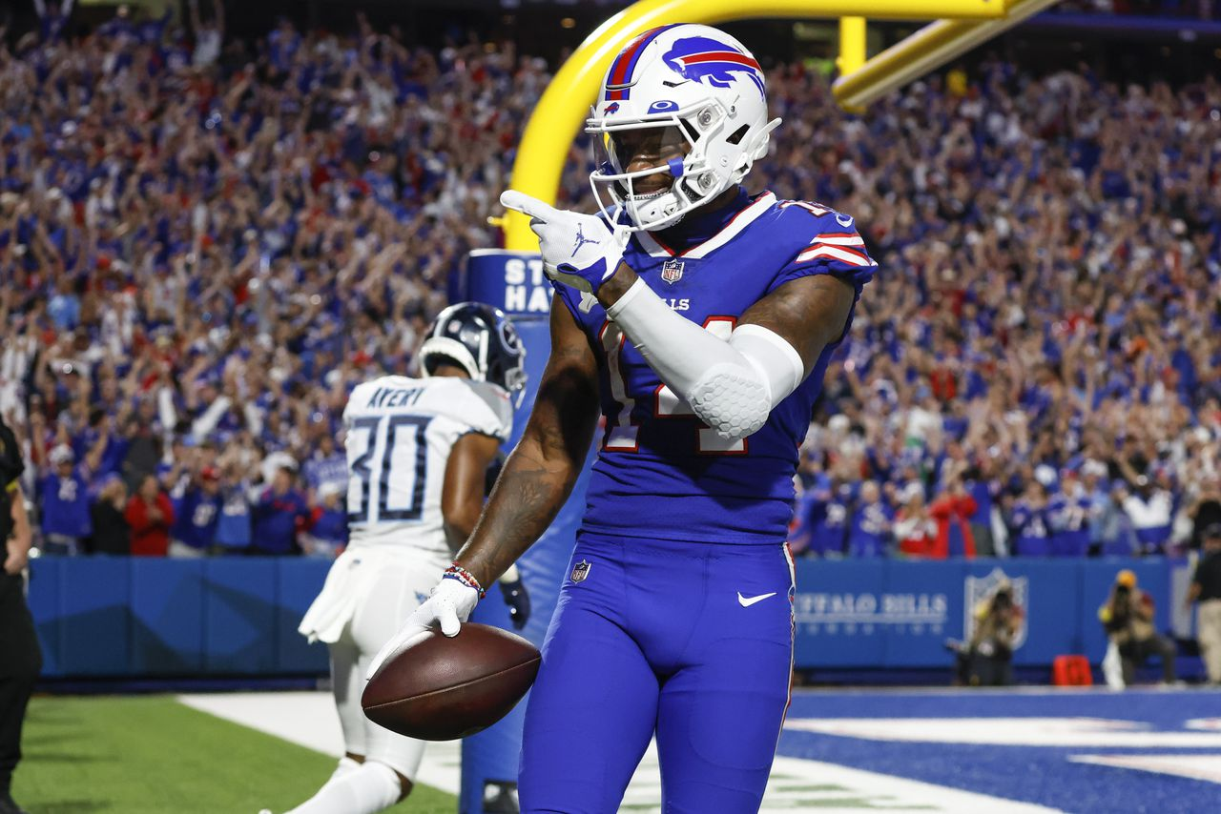
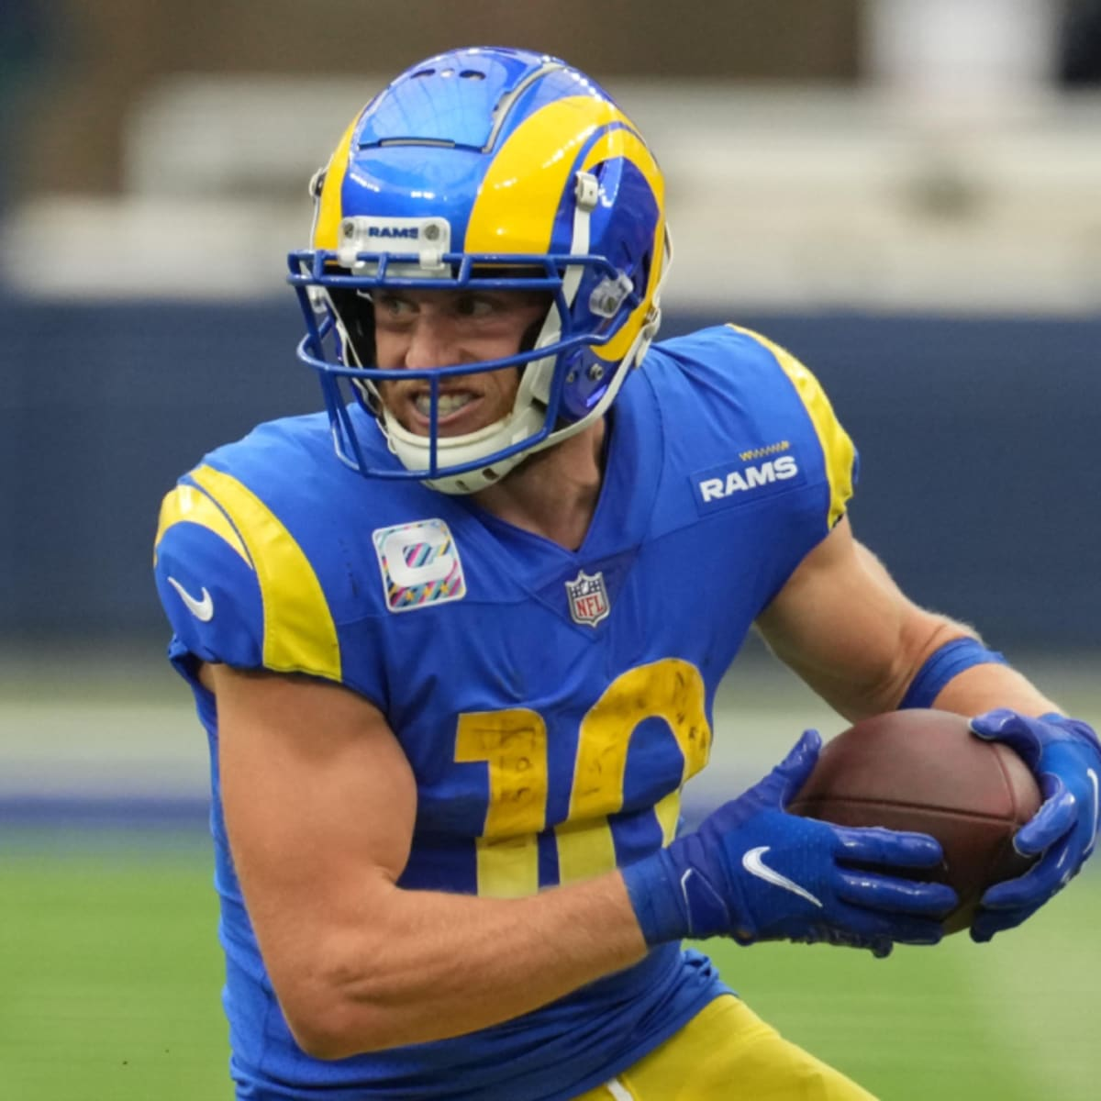
Recap / Takeaways
CONCLUSION
Kupp and Diggs for Week 8!
Top 50 WRs usually have 10+ Points
75+ Receiving Yards is a GOOD GAME, even for top 50!
Number of receptions for a player is a good tell!

Slide 36
Potential Issues
Why no Prediction and Confidence Intervals for Bootstrapping
Dataset Flaws (only top 50 per week leads to different data than ALL receivers)
Potential for Over-Fitting of Data
FUTURE STUDY
Future Studies
Looking at prediction models with more data to source
Looking at multiple positions
Taking matchup into account when making projections

Slide 37
Vaughn Hajra and Quang Nguyen
THANK YOU! ANY QUESTIONS?
November 2, 2022
Stats 226

Slide 38
Sources
Bootstrapping idea from https://www.fantasyfootballdatapros.com/blog/intermediate/7
Photos all via Google Images
Negative Binomial Simulation Ideas from https://rpubs.com/mpfoley73/458738
Wikipedia used for many of the distribution research

